Slide 1
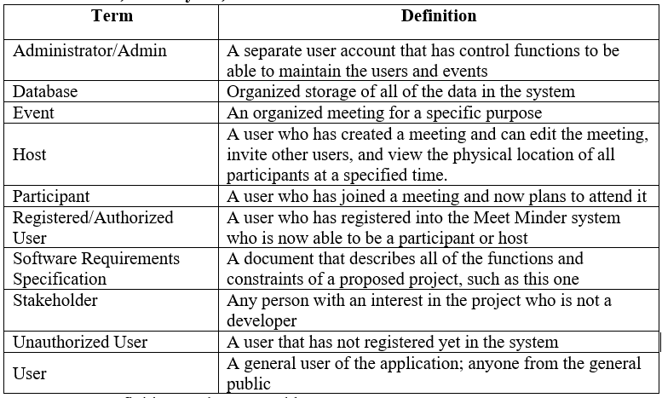
Meet Minder SRS Document
5 revisions versions – 0.1, 0.2, 1.0, 1.1, and 1.2
In the Software Specification Requirements Part 1, we introduced the project and its purpose and came up with a list of terms as well.
In Part 2, the overall project was described
Product perspective – for group collaboration and meetings for mid-twenties to mid-forties
UI Screens listed
Product Functions
User registration
Login
Switch views
Create/Edit events
Parts 1 and 2 are for the customers

